Slide 1
Gametes and Fertilisation

Slide 2
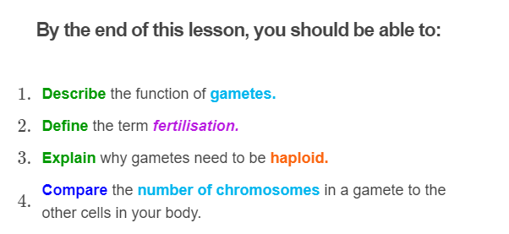

Slide 3
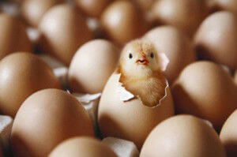
Gametes are the product of another type of cell division called meiosis.
Before learning about meiosis, it is useful to learn about gametes.

Slide 4
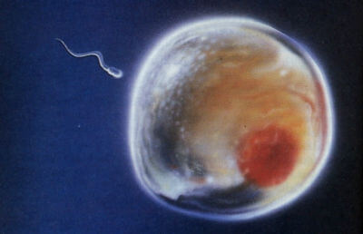
Gametes are special cells used in sexual reproduction.
In humans, these are the sperm and the egg (ovum), which are made and stored in the testes and ovaries.

Slide 5
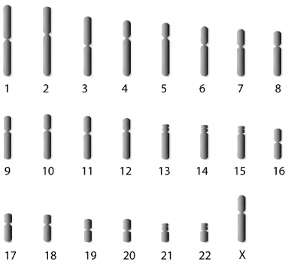
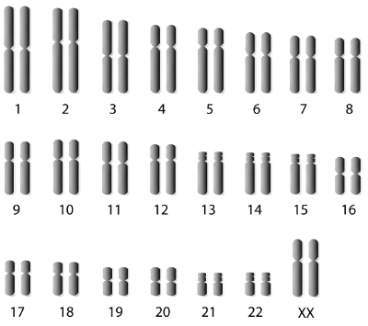
Gametes are the only haploid cells in your body.
This means they have one copy of each chromosome.
All the other cells in your body have two copies, making them diploid.
Gametes
Other cells

Slide 6
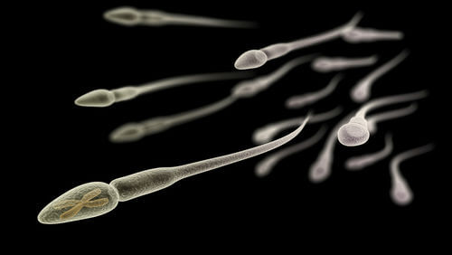
In summary:
1. | Gametes are made during meiosis.
2. | These are the sperm and egg and are used for sexual reproduction.
3. | Unlike the other cells in your body, gametes are haploid.

Slide 7
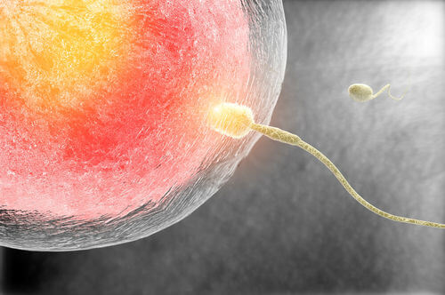
So how are gametes actually used in sexual reproduction?
During sexual reproduction, a sperm cell and an egg cell fuse in a process called fertilisation.

Slide 8
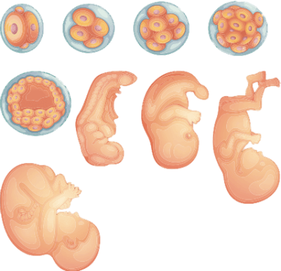
The fusion of the sperm and egg makes a single cell called a zygote.
The zygote cell will grow into an embryo and then a baby by adding new cells through mitosis.

Slide 9
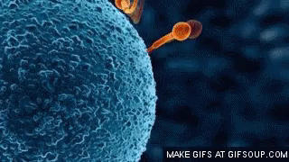
Because the male and female gametes fuse to form the zygote, the zygote inherits all of the chromosomes from each gamete.
This gives the zygote a two copies of each chromosome and makes it diploid.

Slide 10
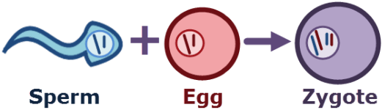
Remember, diploid cells contain a maternal and paternal copy of each chromosome.
This is a result of the fusion of the sperm and egg in fertilisation!
The haploid sperm gives you your paternal copies and the haploid egg gives you your maternal copies.

Slide 11
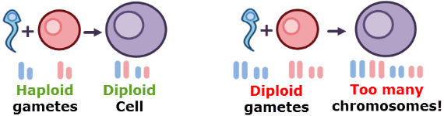
Fertilisation is also the reason that gametes need to be haploid.
The zygote needs one copy of each chromosome from the father and one copy from the mother.
If gametes were diploid, the zygote would inherit two copies from each parent, giving it four copies in total. This would be too many chromosomes. Having too many chromosomes causes lots of problems and would kill the zygote.

Slide 12
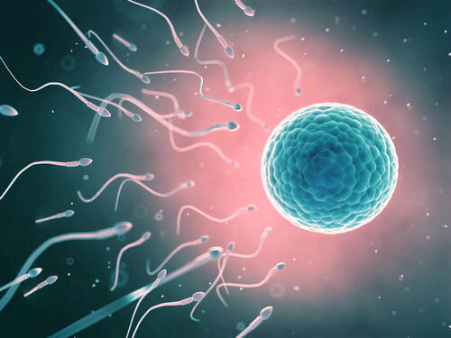
In summary:
1. | In fertilisation, a sperm and an egg fuse to form a zygote.
2. | The zygote is diploid, recieving one paternal copy of each chromosome from the sperm and one maternal copy from the egg.
3. | Gametes therefore need to be haploid to avoid passing on too many chromosomes to the zygote.

